Slide 1
浙海关屋架匠艺梳理
上海交通大学
木建筑研究与设计中心
2026.01
Shanghai Jiao Tong University

Slide 2
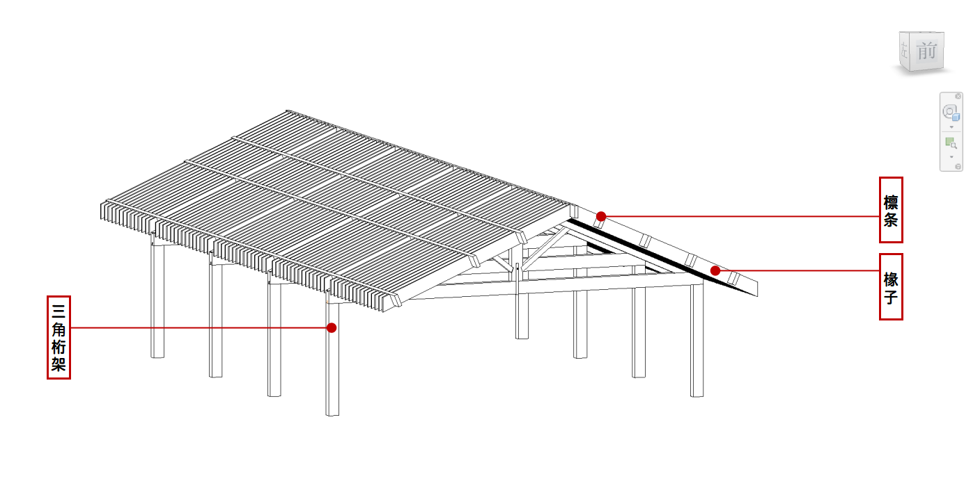
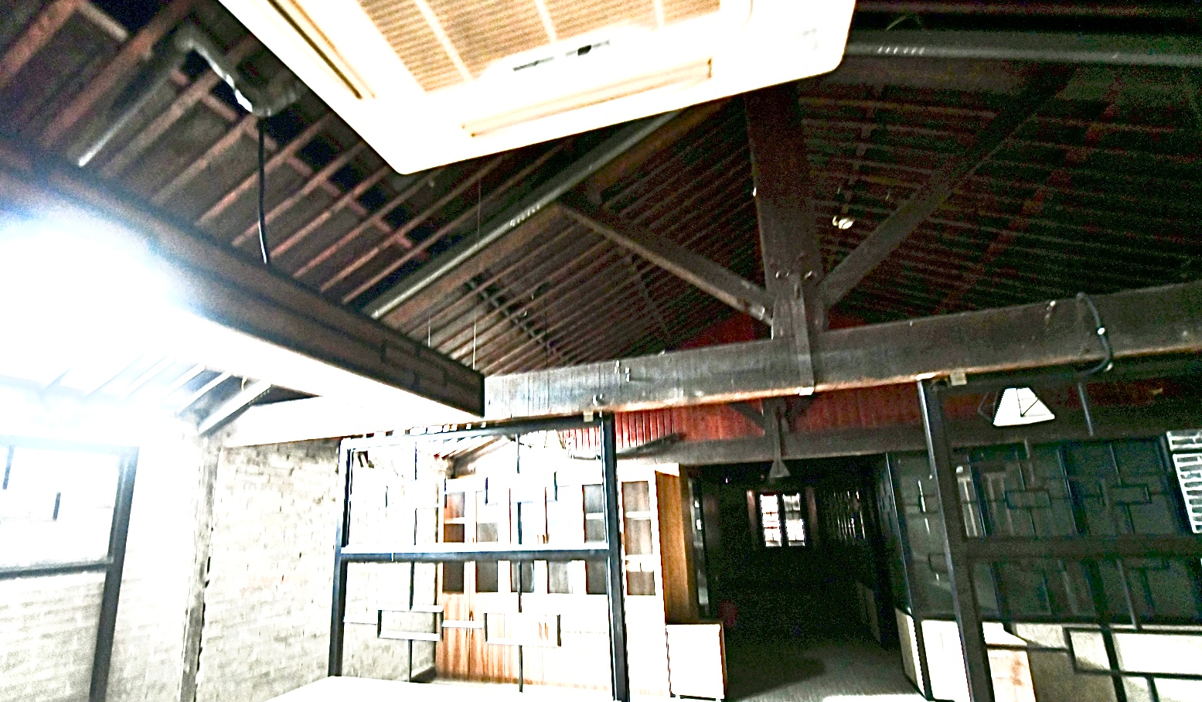
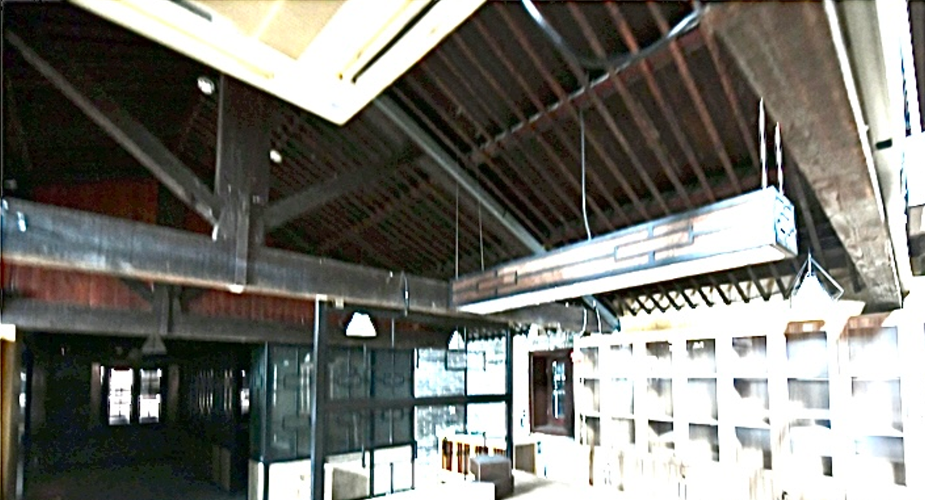
屋架介绍 Introduction to the Roof Structure
屋架结构整体由4榀单柱三角桁架，75根椽子，8根檩条构成,主体为木结构，部分后期加固构件采用金属结构。
The entire roof truss structure consists of 4 single-column triangular trusses, 75 rafters, and 8 purlins. The main body is made of wood, with some later-added reinforcement components using metal structures.
Purlin
Rafter
Triangular Truss
图1：屋架轴测图
Figure 1: Axonometric View of the Roof Truss
图2：屋架实拍图
Figure 2: Actual Photo of the Roof Truss
Shanghai Jiao Tong University

Slide 3
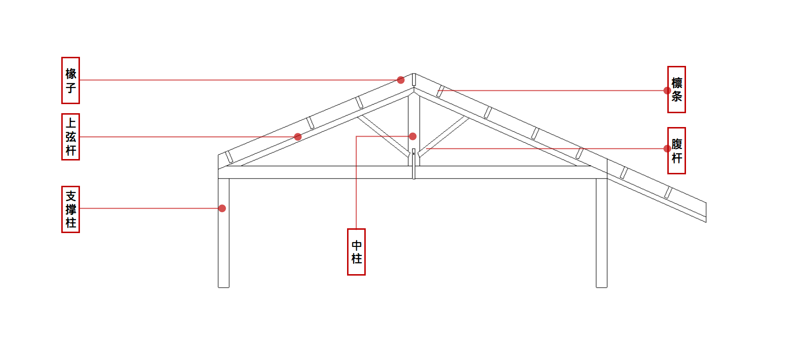
屋架介绍 Introduction to the Roof Structure
屋架结构整体由4榀单柱三角桁架，75根椽子，8根檩条构成,主体为木结构，部分后期加固构件采用金属结构。
The entire roof truss structure consists of 4 single-column triangular trusses, 75 rafters, and 8 purlins. The main body is made of wood, with some later-added reinforcement components using metal structures.
Rafter
Purlin
Top Chord
Web Member
Support Column
Central Column
Bottom Chord
下弦杆
图3：单柱三角桁架正立面图
Figure 3: Front Elevation View of the Single-Column Triangular Truss
图2：屋架实拍图
Figure 2: Actual Photo of the Roof Truss
Shanghai Jiao Tong University

Slide 4
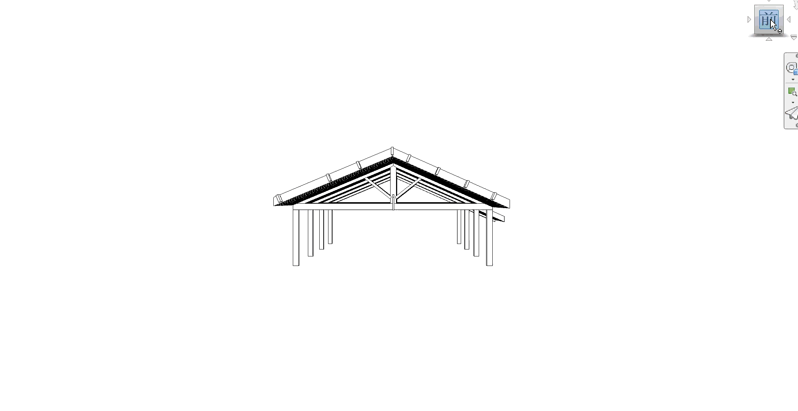
屋架介绍 Introduction to the Roof Structure
屋架结构整体由4榀单柱三角桁架，75根椽子，8根檩条构成,主体为木结构，部分后期加固构件采用金属结构。
The entire roof truss structure consists of 4 single-column triangular trusses, 75 rafters, and 8 purlins. The main body is made of wood, with some later-added reinforcement components using metal structures.
图4：屋架动态展示
Figure 4: Dynamic Display of the Roof Truss
Shanghai Jiao Tong University

Slide 5
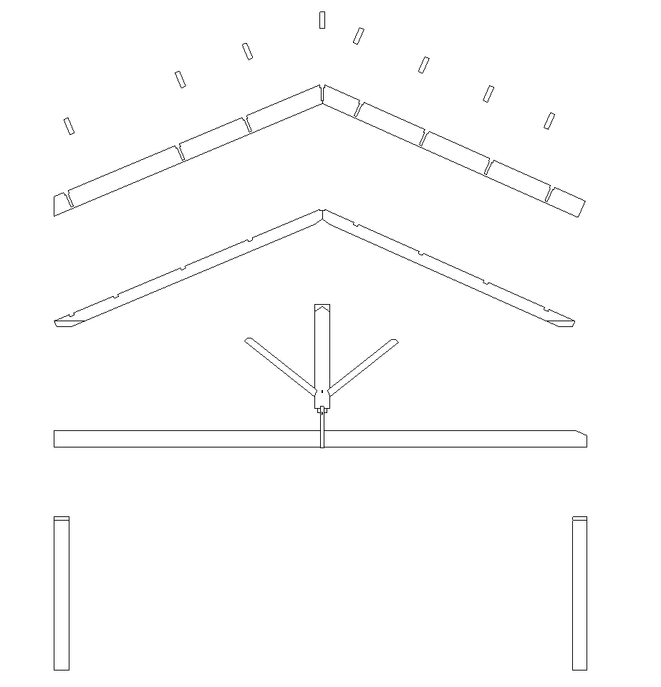
结构节点介绍 Introduction to Structural Joints
节点插接方式主要为以下三种类型：
1.倾斜交叉，例如上弦杆和中柱、中柱和腹杆
2.垂直交叉，例如中柱和下弦杆
3.十字交叉，例如檩条和椽子
The node insertion methods mainly include the following three types:
1.Inclined crossing, e.g., between the top chord and the middle column, and between the middle column and the web member
2.Vertical crossing, e.g., between the middle column and the bottom chord
3.Cruciform crossing, e.g., between the purlin and the rafter
檩条
Purlin
椽子
Rafter
上弦杆
Top Chord
Central Column
中柱
Web Member
腹杆
下弦杆
Bottom Chord
Support Column
支撑柱
Shanghai Jiao Tong University

Slide 6
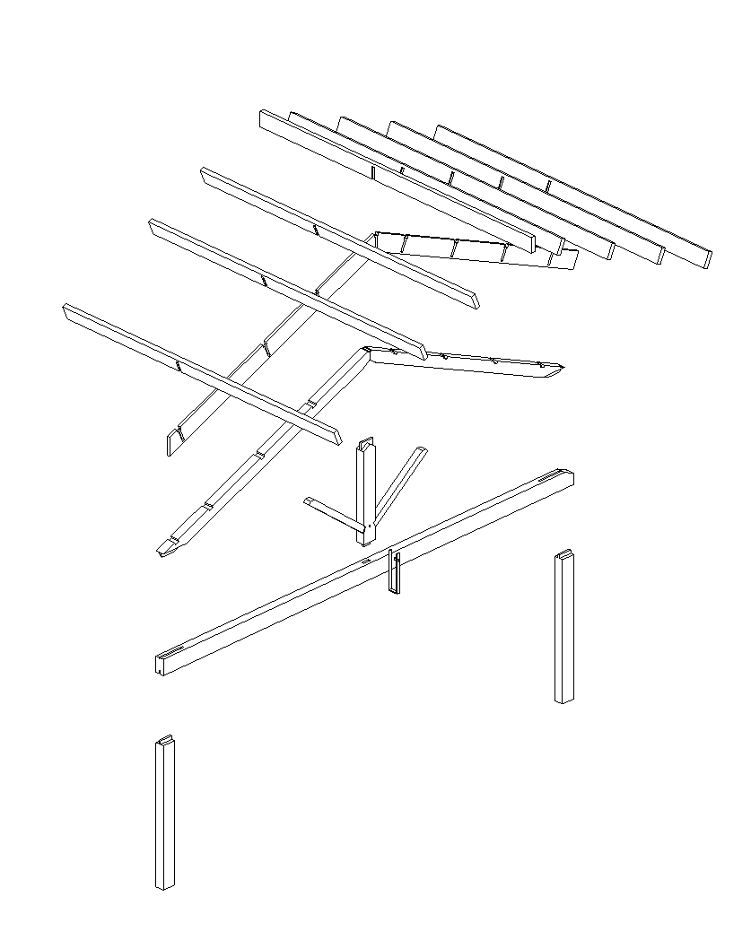
结构节点介绍 Introduction to Structural Joints
节点插接方式主要为以下三种类型：
1.倾斜交叉，例如上弦杆和中柱、中柱和腹杆
2.垂直交叉，例如中柱和下弦杆
3.十字交叉，例如檩条和椽子
The node insertion methods mainly include the following three types:
1.Inclined crossing, e.g., between the top chord and the middle column, and between the middle column and the web member
2.Vertical crossing, e.g., between the middle column and the bottom chord
3.Cruciform crossing, e.g., between the purlin and the rafter
Shanghai Jiao Tong University

Slide 7
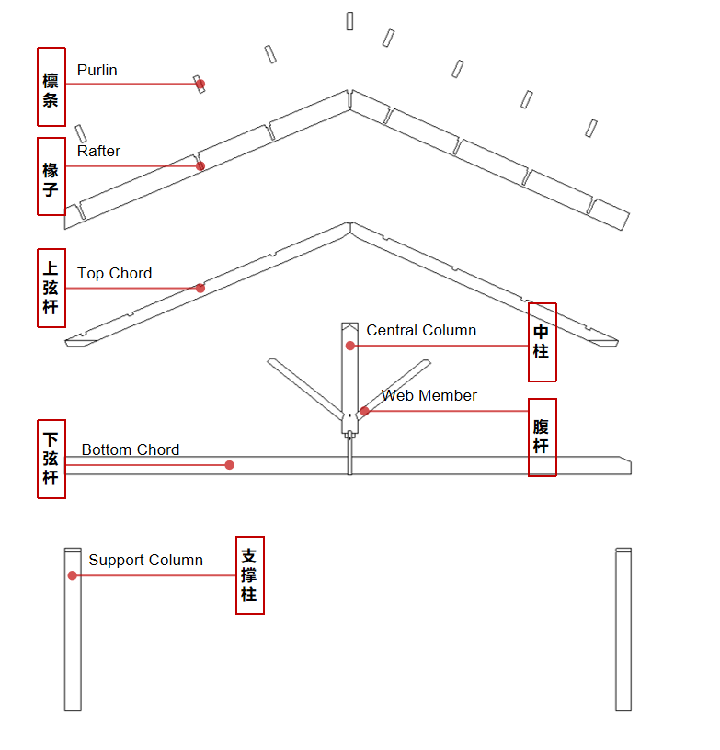
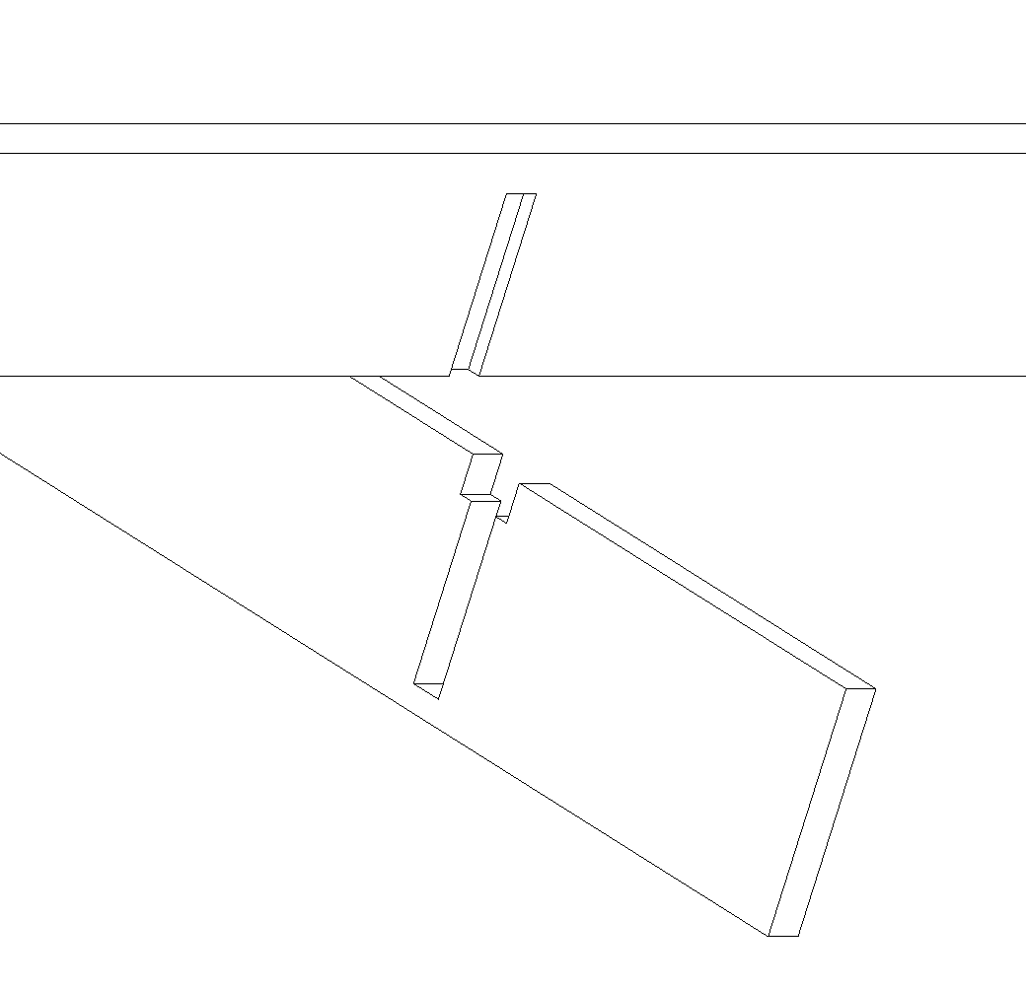
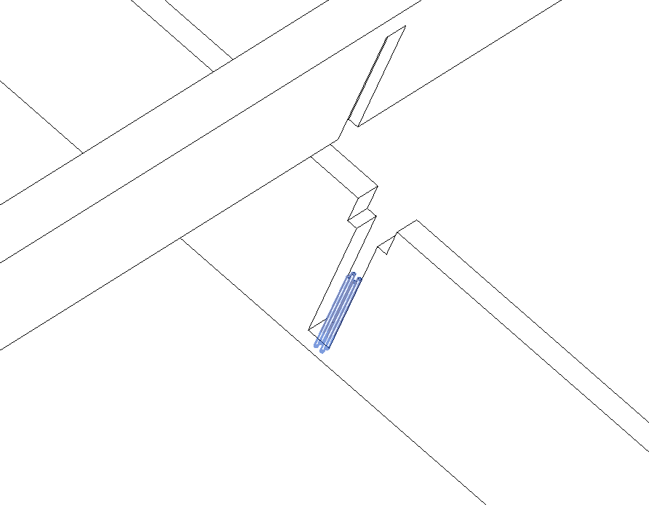
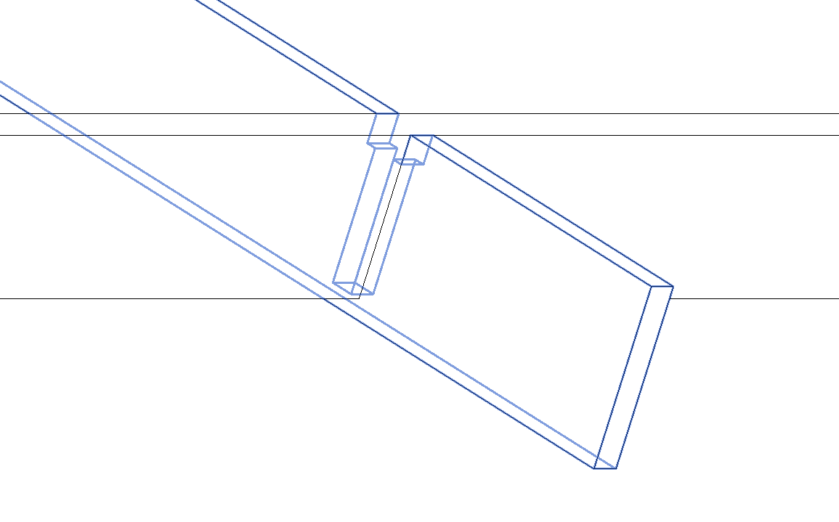
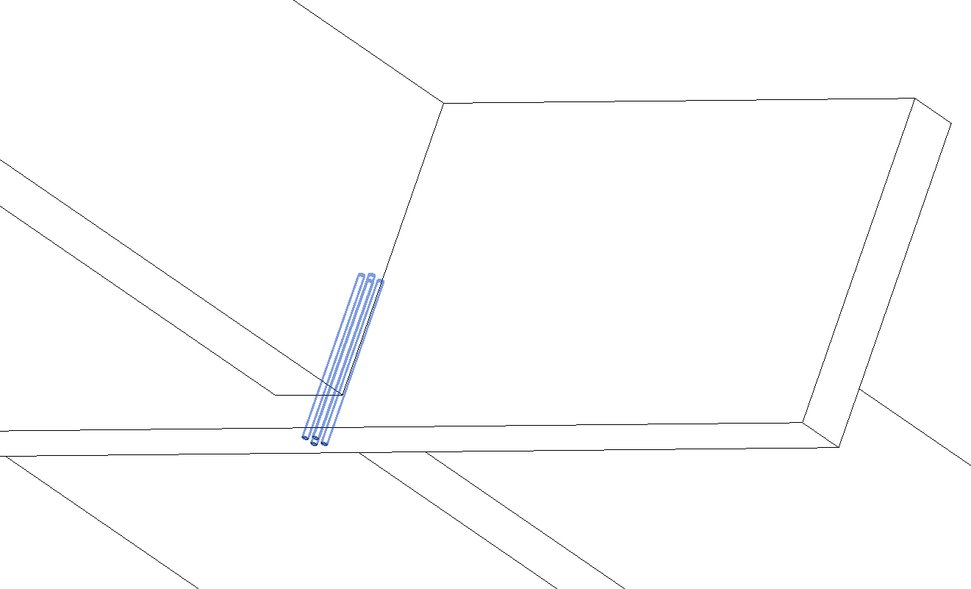
结构节点介绍 Introduction to Structural Joints
檩条和椽子：十字交叉
连接节点：椽檩上皮齐平，开榫相接，椽子下皮加钉固定.
Purlins and Rafters: Cross Crossing
Connection Joint: The upper surfaces of the rafters and purlins are flush, connected by tenons, and the lower surfaces of the rafters are fixed with nails.
开榫槽边角接合
Corner Joint with Mortise and Tenon Groove
金属钉加固
Reinforcement with Metal Nails
Shanghai Jiao Tong University

Slide 8
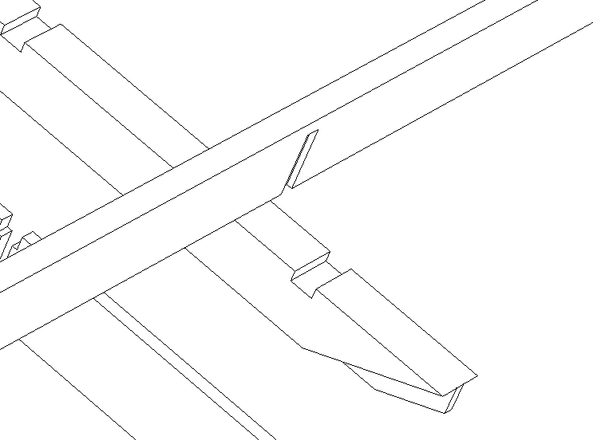
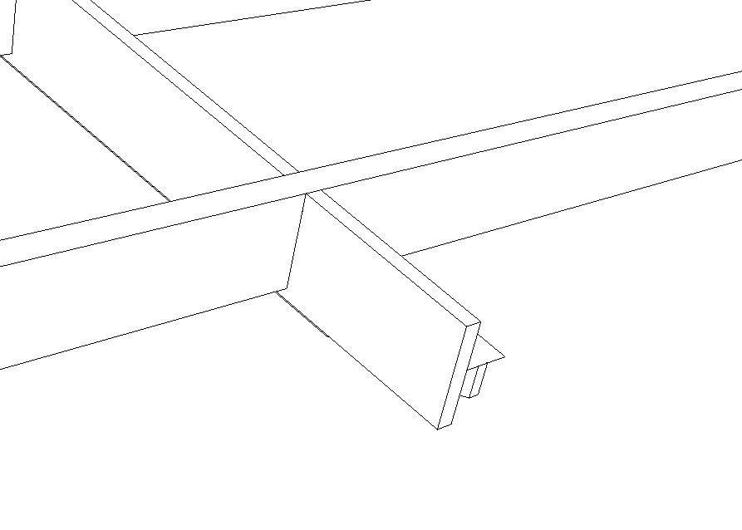
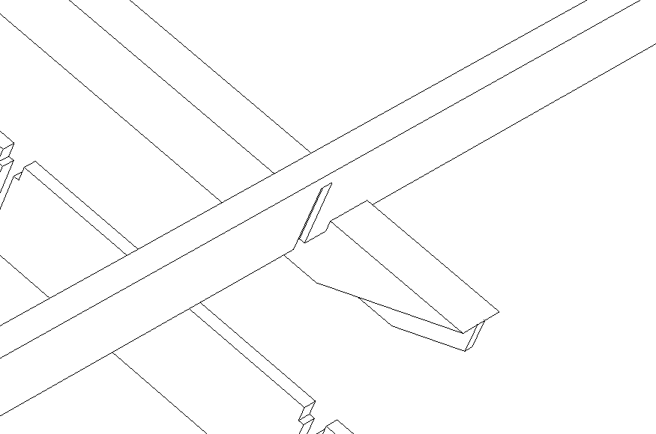
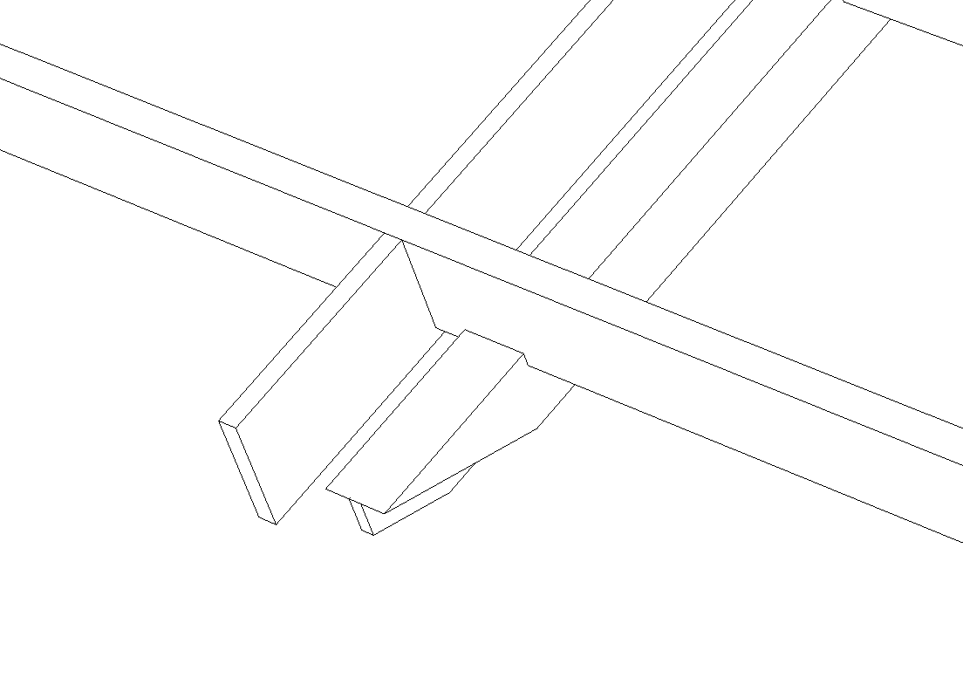
结构节点介绍 Introduction to Structural Joints
檩条和上弦杆：十字交叉
连接节点：开榫槽插接
Purlins and Top Chords: Cross Crossing
Connection Joint: Mortise Groove Insertion
开榫槽十字插接
Tenoned Cross Insertion
檩条、上弦杆、椽子位置关系示意Positional Relationship Among Purlins, Top Chords and Rafters
Shanghai Jiao Tong University

Slide 9
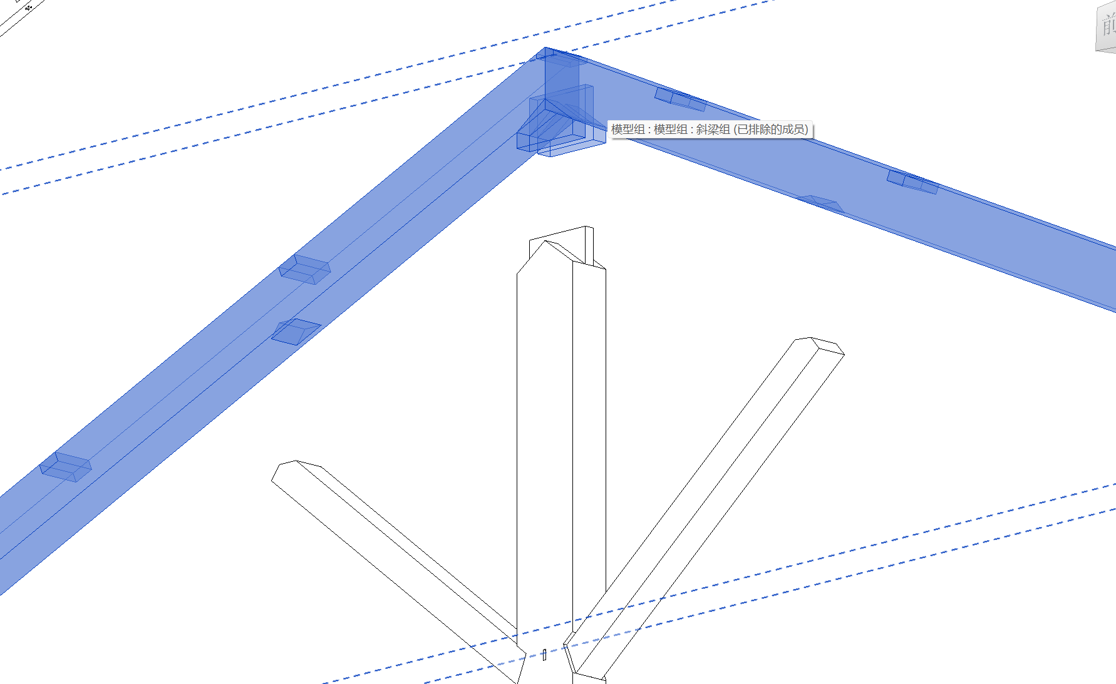
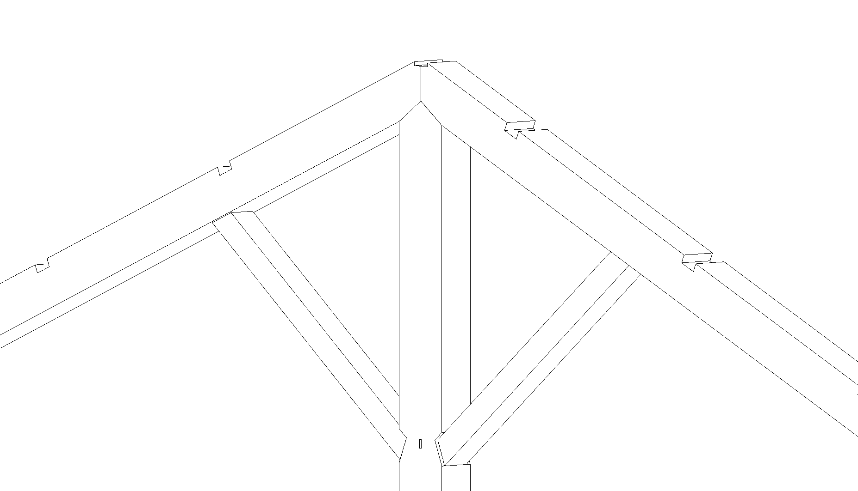
结构节点介绍 Introduction to Structural Joints
上弦杆和中柱/腹杆：倾斜交叉
上弦杆和中柱连接方式：斜双格肩榫接合
上弦杆和腹杆连接方式：开榫槽斜插
Top Chords and Middle Columns/ Web members: Inclined Crossing
Connection method between top chords and middle columns: Obliquely double-shouldered tenon joint
Connection method between top chords and web members: mortise groove oblique insertion
大格肩榫接合
Shoulder Tenon Joint
开榫槽斜插
Mortise and tenon oblique insertion
Shanghai Jiao Tong University

Slide 10
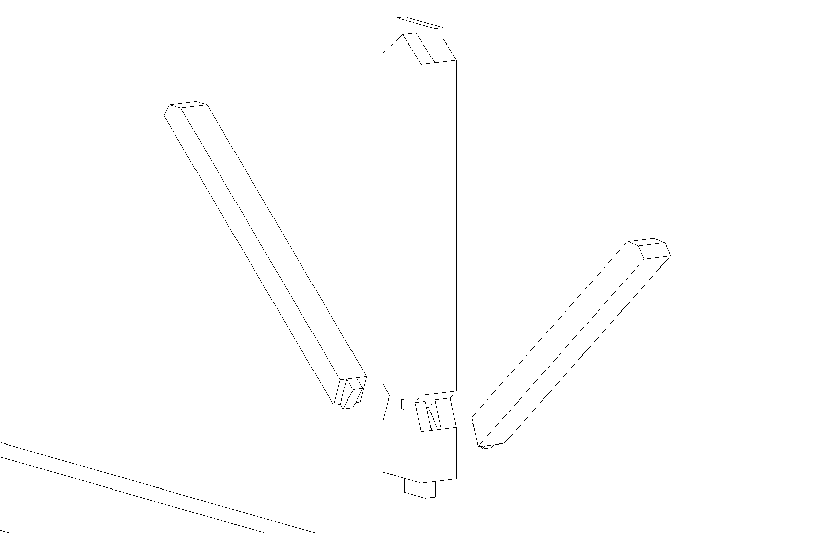
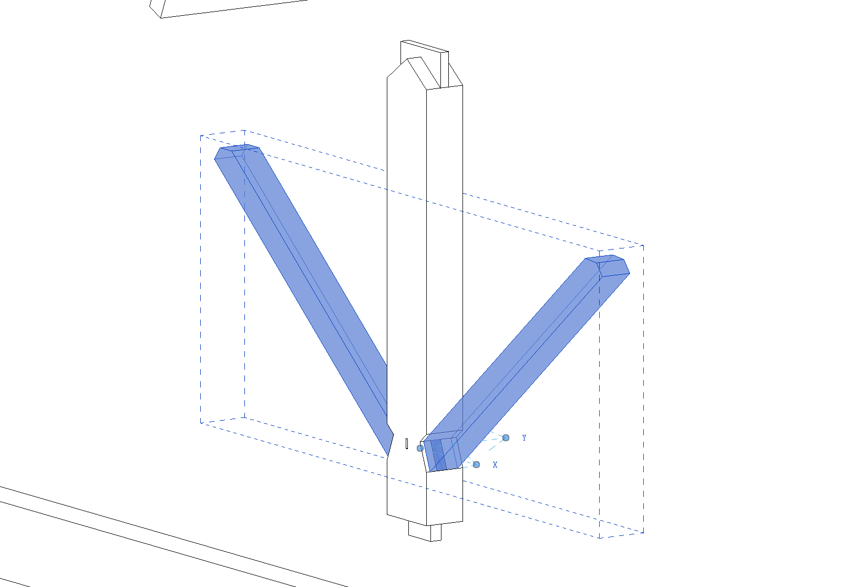
结构节点介绍 Introduction to Structural Joints
中柱和腹杆：倾斜交叉
连接方式：肩榫接合
Middle Columns and Web members: Inclined Crossing
Connection Method: Shoulder Tenon Joint
Shanghai Jiao Tong University

Slide 11
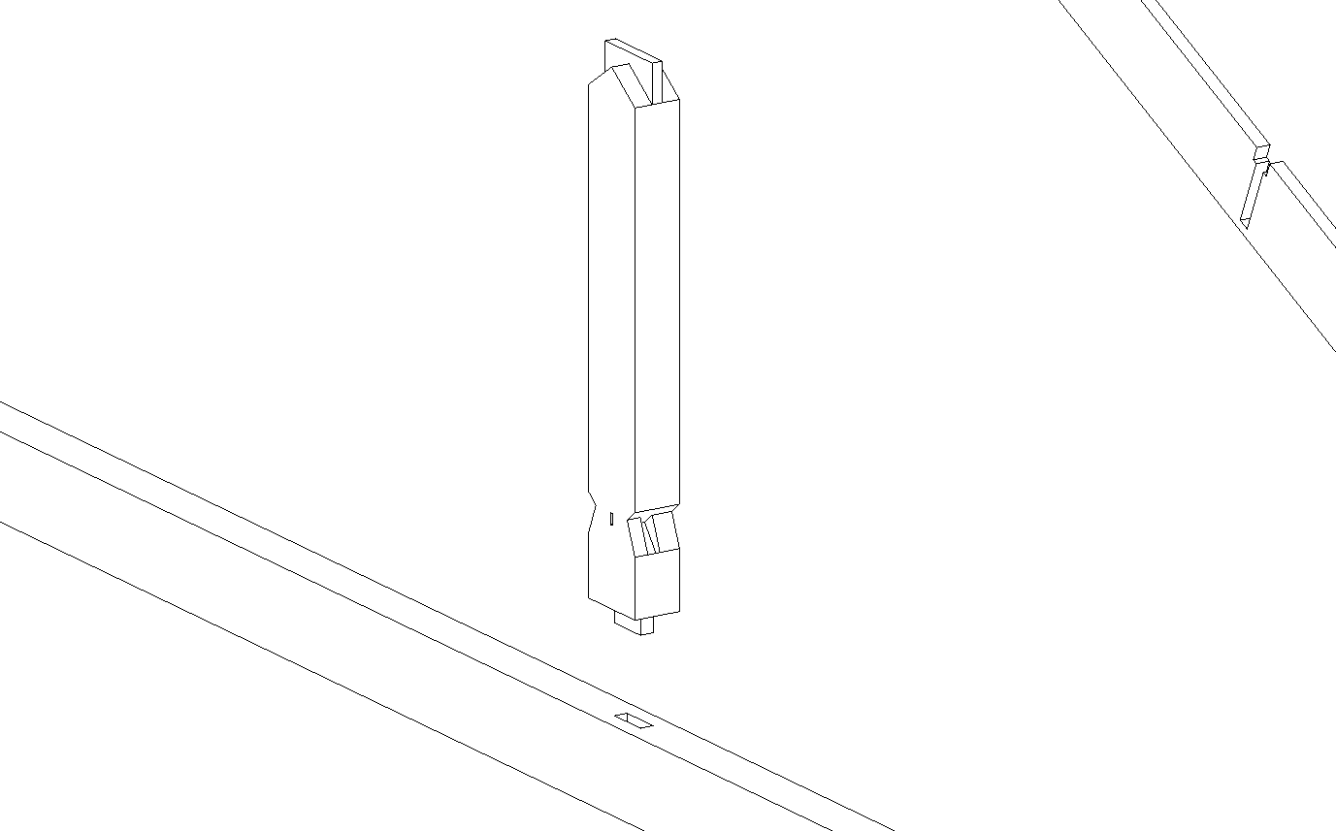
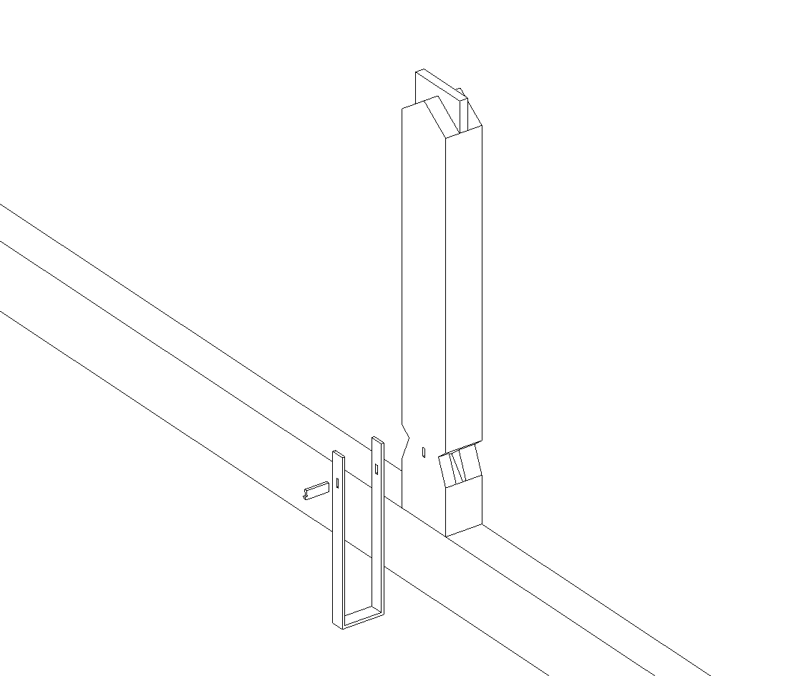
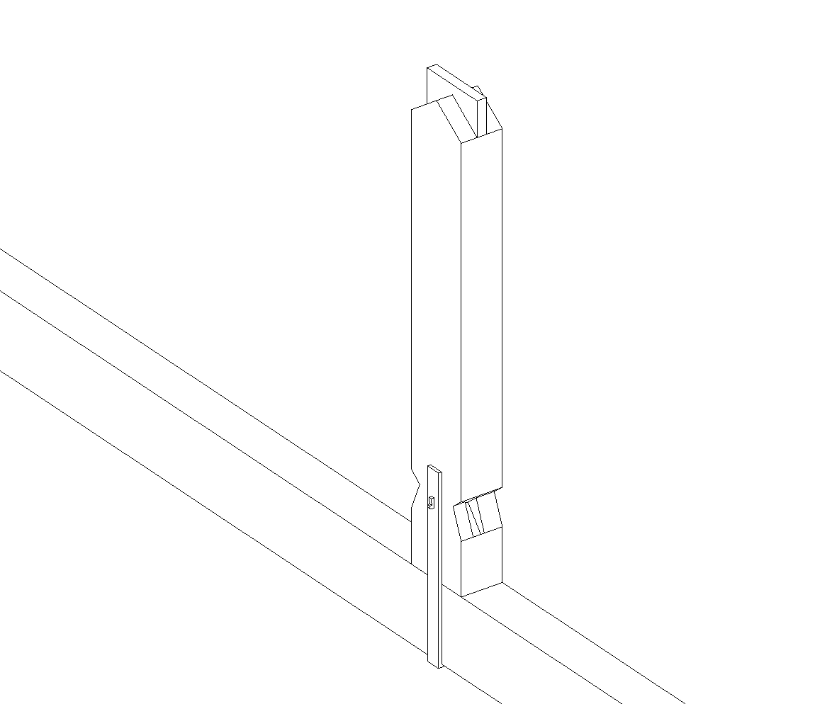
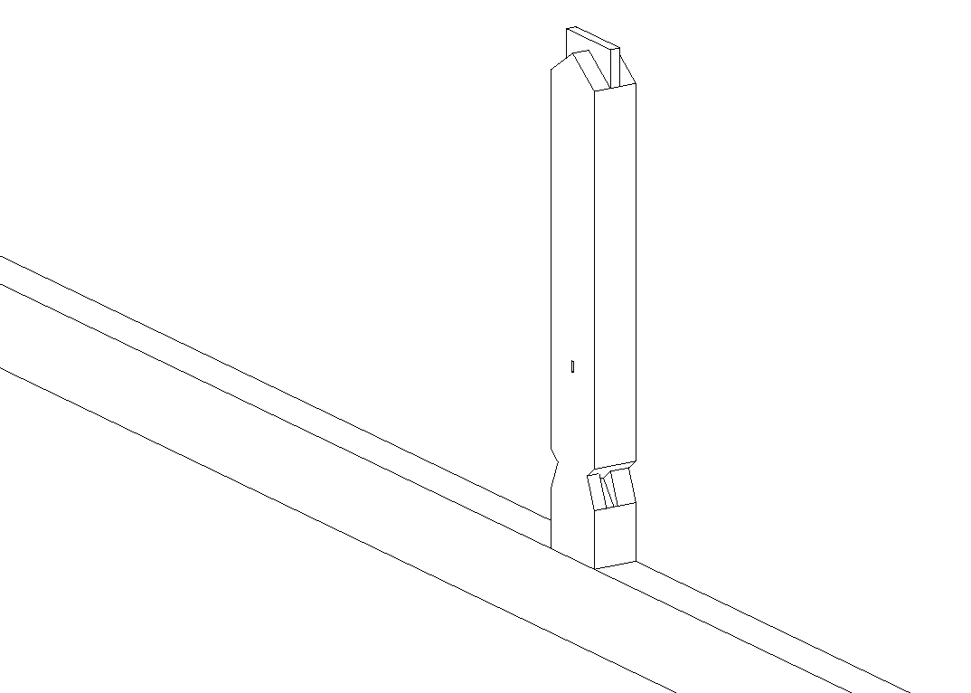
结构节点介绍 Introduction to Structural Joints
中柱和下弦杆：垂直交叉
连接方式：直榫接合+金属件固定
Middle Columns and Bottom Chords: Vertical Crossing
Connection Method: Straight Tenon Joint + Metal Fastener Fixing
直隼接合
Straight Tenon Joint
金属件固定
Metal Fastener Fixing
Shanghai Jiao Tong University

Slide 12
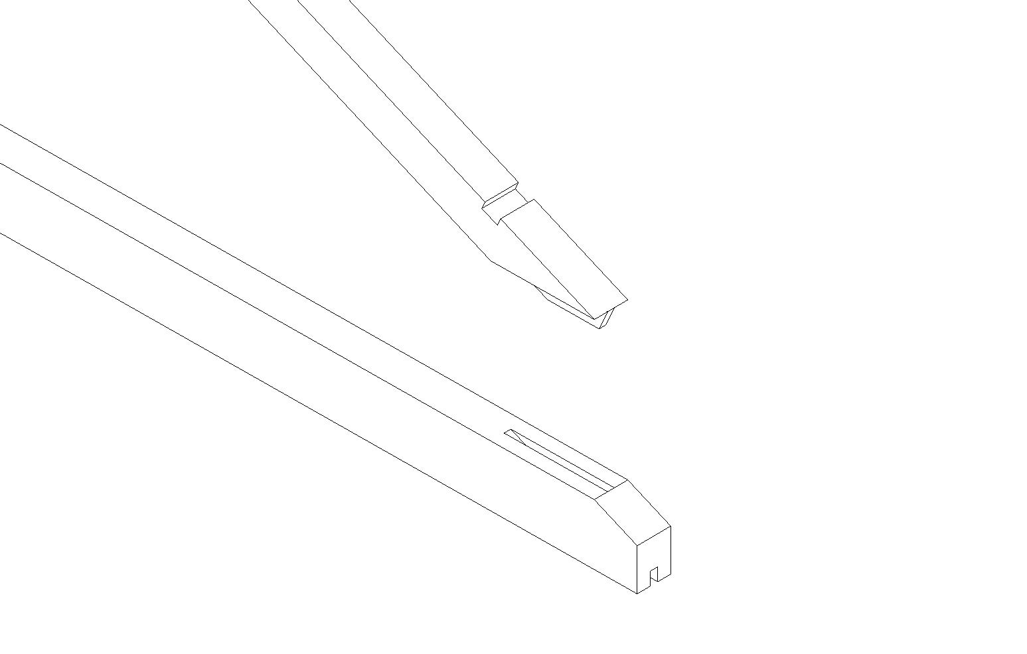
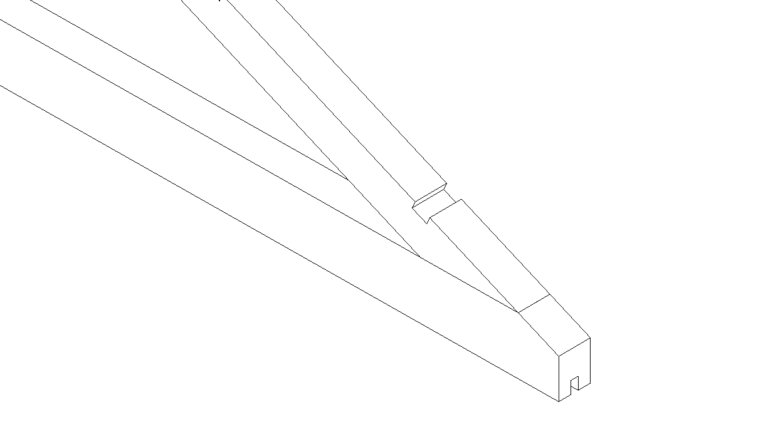
结构节点介绍 Introduction to Structural Joints
上弦杆和下弦杆：倾斜交叉
连接方式：斜大格肩榫接合
Top chords and bottom chords: Inclined crossing
Connection Method: Oblique Large-Scarf Shoulder Tenon Joint
Shanghai Jiao Tong University

Slide 13
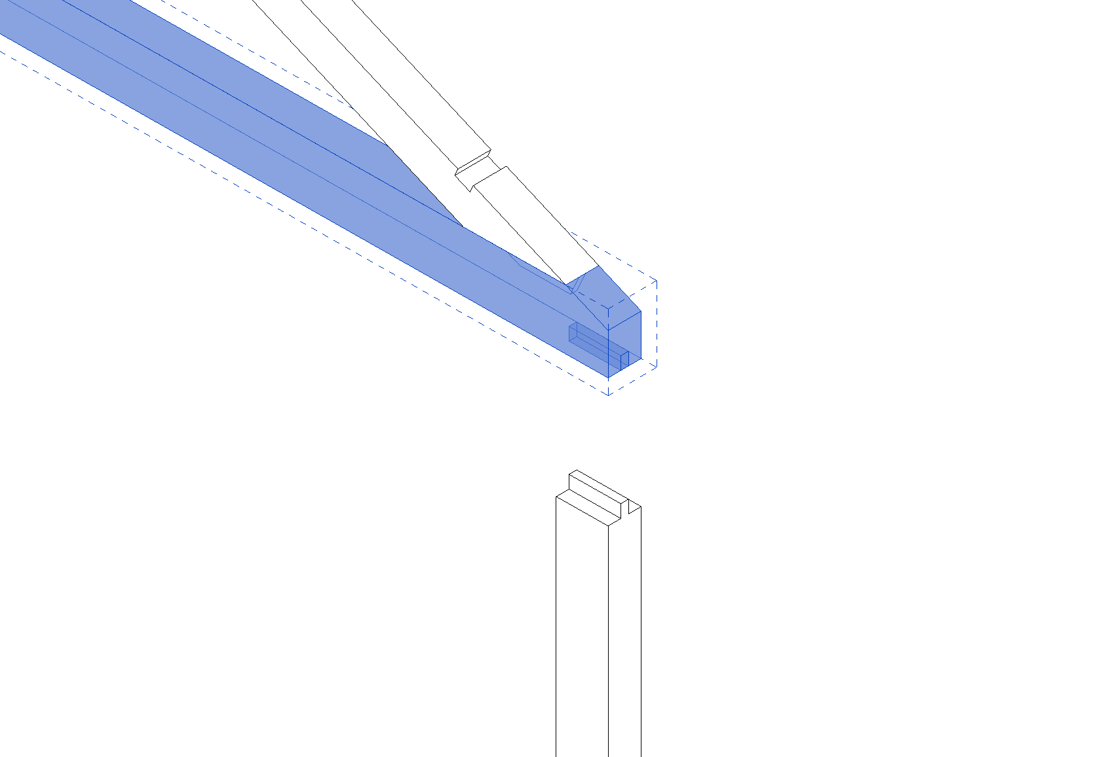
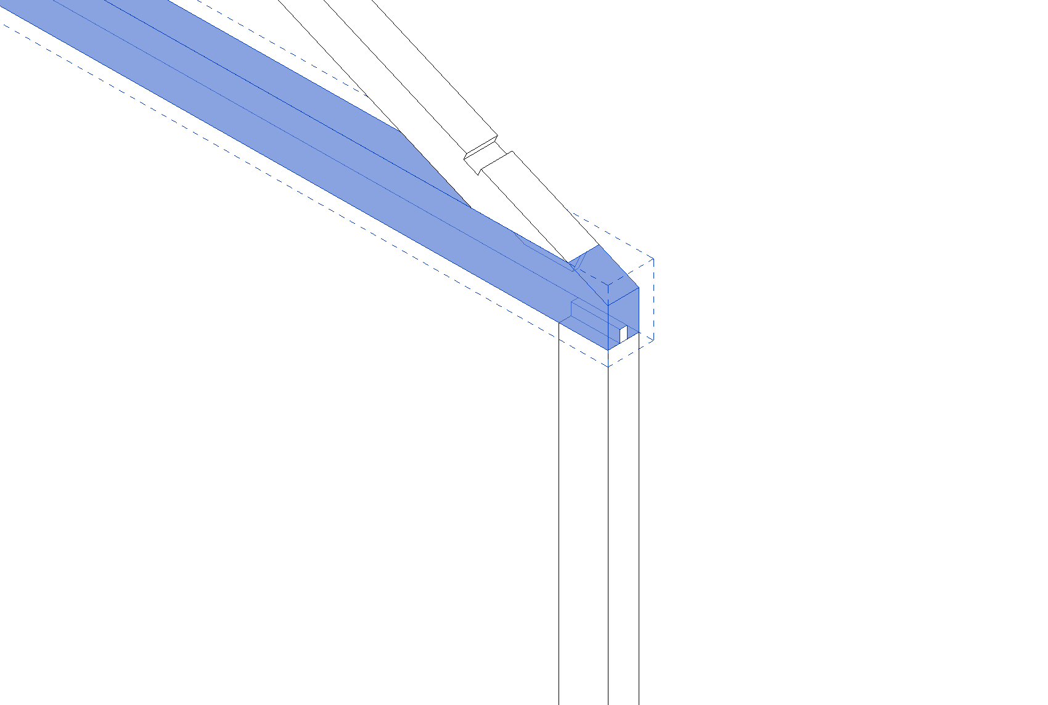
结构节点介绍 Introduction to Structural Joints
下弦杆和支撑柱：垂直交叉
连接方式：直肩榫接合
Top chords and Support Column:Vertical crossing
Connection method: Shoulder tenon joint
Shanghai Jiao Tong University

